Slide 1





Presentation for HHS DAWG
FHA Information Modeling (IM) Project and the Federal Health Information Model (FHIM)
December 2010
Steven Wagner
Program/Project Manager
FHA Standards Program
and Information Modeling Project

Slide 2
Agenda
IM Project/ FHIM Context
Overview of FHIM and Associated Terminology Models/Value Sets
Overview of Implementation Modeling Tools
How the Models/Tools Support the S&I Framework
Summary

Slide 3
IM Project and FHIM Context
      Staffed by LC Members (guides FHIMS WG by setting
      priorities and developing/approving strategy)
Staffed by FHA Program Manager and potentially other
support resources (manages FHIMS WG and supports
FHIMS Steering Group and all projects)
Staffed by Federal partner resources (2-3 project leads
and at least one contact/participant from each Federal
partner)
      Steering Group for FHIMS WG
      FHIMS WG
      IM Project
      (develops the FHIM)

Slide 4
IM Project and FHIM
Steering Group and Modeling Participants
Steering Group Members:
DoD [Nancy Orvis] SSA [Justine Piereman] CDC [Nikolay Lipskiy] VHA [Tim Cromwell] NCI [George Komatsoulis] CMS [Theresa Lissauer]
Information Modeling Project comprised of volunteers from:
DoD/MHS | CDC
VA / VHA | SSA
HHS | SAMHSA
CMS | IHS
FDA | NCI
NLM | FHA
All are encouraged to invite
Subject Matter Experts (SMEs)
from their respective organizations
to provide insight and input on
models, standards, and definitions.

Slide 5
FHIM and Associated Terminology Models
Goal and Principles
Goal
  Produce a logical, health information model that supports semantic interoperability and that is built by harmonizing information from the individual Federal partners and standards organizations
Principles
  The model will be expressed in standard Unified Modeling Language (UML) notation (it may also be expressed in other notations)
  The model will be designed to meet all Federal partner semantic interoperability needs for the exchange of information with other organizations
  The model will support existing national health standards
  The model will be in the public domain, freely available and easy to access
  The model will be specified as a logical model consisting of a set of domain models
  The model will not specify behaviors (operations) and, at least initially, will not specify OCL constraints or rules
  The model will be made available as an XMI export

Slide 6
FHIM and Associated Terminology Models
Approach
Initial baseline model created by drawing on existing UML models from VHA, NCI and FDA
HL7 Reference Information Model (RIM) used as a reference model for the FHIM
Developed using a standard process and style guide
  Lead FHIM modeler ensures consistency, integration and harmonization across domain models
  Health information divided into domains (e.g., Person, Laboratory, Medications/Pharmacy, etc.) - each domain has a modeling team
    Modeling team consists of lead modeler, SMEs, Federal partner liaisons, others
  Model each domain starting with existing information from baseline model
  Incorporate and harmonize information from Federal partners
  Incorporate and harmonize information from standards organizations
The FHIM is versioned and stored in a GForge repository as it is developed
The FHIM is distributed for review/feedback by Federal partners

Slide 7
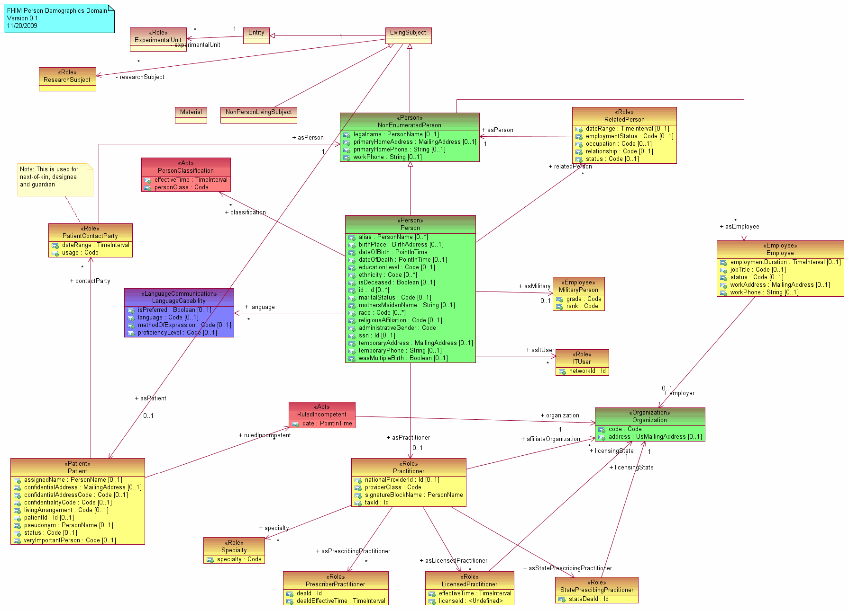
FHIM and Associated Terminology Models
Process
Sept 2009
Nov 2009
Dec 2009
Jan 2010 … ongoing…
Draft
Models /
Document
Concepts
& codes
Provide
Models, Specs,
Definitions to SDOs & Agencies
Define
Strategy
Define
Modeling
Process
Define
Style
Guide/
Tools
Vet
Model &
Concepts
Generate
Interoperability
Specifications
Gather
Participants
Establish
Workgroups
Harmonize
Feedback
Repeats for each domain
Create a baseline model from existing VA, NCI and FDA models
Use the HL7 RIM as a reference model
Harmonize information across the FHA Federal Partners/Agencies
Harmonize with information defined by health SDOs and HITSP
Identify concepts and terminologies in need of harmonization
Fully document coded data attributes and their value sets
Vet model, terminologies/value sets and definitions with FHA Federal Partners/Agencies and harmonize final comments
Use model driven architecture approach to produce interoperability specifications
Integrate model approach and content into existing SDO development processes
Interoperability specifications available for FHA Partners/Agencies to leverage

Slide 8
FHIM and Associated Terminology Models
Traceability
FHIM links to terminology models/value sets by storing a unique value set ID
Terminology models maintain all other terminology information (a terminology model/value set links to the FHIM by storing the ID of the data attribute in the FHIM that it supports)
FHIM maintains traceability to use cases and the HL7 EHR-S Functional Model
FHIM incorporates information from Computational Independent Models (CIMs)
FHIM is a Platform Independent Model (PIM)

Slide 9
FHIM and Associated Terminology Models
Priorities
Modeling priorities for the FHIM are set by a Steering Group of six Federal partners (CMS, DoD, VA, SSA, CDC, and NCI)
FHIM priorities include full support for information domains specified by Clinical Care Document (CCD) and Meaningful Use
Eleven Federal partners are participating directly in the Information Modeling (IM) Project (VA, DoD, FDA, CDC, NCI, HHS, CMS, IHS, SSA, SAMHSA and NLM)
All other Federal partners have the opportunity to participate through model reviews/feedback

Slide 10
FHIM and Associated Terminology Models
Current Status of Information Domain Modeling
Domains Already Modeled
  Person
  Security and Privacy
  Eligibility, Enrollment, Coordination of Benefits
  Behavioral Health Assessments
Currently Being Modeled
  Lab
  Medications/Pharmacy (including immunizations)
  Problem
Domains Scheduled to Be Modeled
  Orders (General)
  Allergies
  Vital Signs
  Encounters

Slide 11
Model Driven Architecture (MDA) View
Describing Relationship Between FHIM and NIEM
Business Models
(BPMN & BPEL)
Used to Generate
Used to Generate
Software Behavior Models
(UML)
Logical (Static) Information Models
(UML)
Used to Generate
This is
FHIM
Used to Generate
Used to Generate
Used to Generate
Information Exchange (IEPD) Models
(XML Schemas)
Physical Databases
(Relational or Other DB)
This is NIEM
Used to Generate

Slide 12
Model Driven Architecture (MDA) View
Integration of FHIM, NIEM, HITSP and Health SDOs
Federal Health Information Model (FHIM)
Contribute
Data To
Provides
Information
To
Contributes
Data To
HITSP
Contributes
Data To
Open Health Tools (OHT)
UML Tools
Health SDOs
HL7 & Others
Contributes
Process To
NIEM
Contributes
Process To
Produces
Contributes
Process To
XML Schema
IE Documentation
Certification Criteria

Slide 13
FHIM and Associated Terminology Models
Benefits
The models retain use case context
The models are integrated (2-way links between Information Terminology models)
The modeling process harmonizes content (information and terminology) across organizations
The models support efficient standards development
The models are being integrated with the MDHT to support a model-driven approach to development of information exchange interoperability specifications
The models can be leveraged by organizations for internal use in systems and database development
The models are developed using standard UML

Slide 14
Overview of Model-Driven Health Tools
Open source project within Open Health Tools (OHT)
Based on Eclipse Platform - template driven and extensible
First tooling release in Jan 2011 targeting full-lifecycle support for CDA
  UML design of implementation guides
  Publishing ballot specs and developer docs
  Generating validation and Java runtime support
Prototype started using non-CDA base models (e.g. FHIM, NIEM core, NCPDP) in MDHT tooling and generating XSD implementation, in addition to Java
Can generate multiple implementation (PSM) models
Three user roles of MDHT apply to CDA and other base models

Slide 15
MDHT Project Benefits for Three Users Roles
Standards organizations
  Formalize representation of implementation guide conformance rules
    Replace current practice of using MS Word for specification development
    UML specification is testable for consistency and use of best practices
    Enables automated model-driven development and code-generation
  Automate publication of implementation guides in multiple formats (PDF and XHTML) and alternative content structure (ballot document vs. implementer view)
  Automate generation of XML instance validator from specification model (using Java and OCL)
Business Analysts
  Consistent format of published implementation guide between different standards organizations (HL7, IHE, and HITSP)
  Cross-referenced, hyperlinked reference material accelerates analysis and EHR mapping
  Publish a “developer view” of implementation guide that combines conformance rules from all inherited templates and base core model type
Java Implementers
  Reduce Development Cost: Time and resources for analysis and implementation of content and conformance rules
  Reduce Maintenance Cost: High quality, domain-specific API for programmatic access to model content, and validating conformance with standard implementation guide rules (e.g. CCD and HITSP C32/C83)
  Future support planned for non-Java implementation languages

Slide 16
Publishing and Validation
Publishing Implementation Guides, Normalized Format
  The UML models created with template definitions are automatically transformed to DITA XML (OASIS standard), which is then published to PDF and HTML formats.
  Developer documentation includes the complete aggregate list of all inherited elements and conformance rules. Thus, a developer does not need to "follow the breadcrumbs" of template conformance references. This issue is #1 complaint by developers using HITSP and IHE specifications.
Validating XML Instances
  Conformance rules modeled in UML are transformed to Object Constraint Language (OCL) expressions that are executed by the Java runtime.
  Enables rapid iterative development of specification and conformance test suite.

Slide 17

FHIM Model Driven Prototype
Approach
FHIM Model
(PIM)
1
NIEM Health Domain
Harmonized
Uses
Lab Domain Integration Use Case
Constrains
2
Uses
Platform Independent
Lab Domain Exchange (PIM)
4
5
Platform Specific
MDHT
Transform
CDA Exchange PSM (UML)
NIEM Exchange PSM (UML)
8
Generate
Transform
Transform
Generate
9
6
7
CDA Implementation Guide Document
CDA Exchange Implementation
(Java)
NIEM Exchange PSM Implementation
(XSDs)
NIEM IEPD
Document

Slide 18
CDA Models and Reference Implementations
MDHT team is currently working on UML models and Java implementations of the following CDA-based document types:
  HL7 Continuity of Care Document (CCD)
  IHE Patient Care Coordination (PCC) Profiles
  HITSP C83 and C32 Patient Summary
  HL7 Public Health Case Report (PHCR)
  IHE Lab Report Document
  HITSP C74 Personal Health Monitoring Report
  HL7 Health Story specifications (CDA Common Data Types)
Early prototype of NIEM implementation

Slide 19
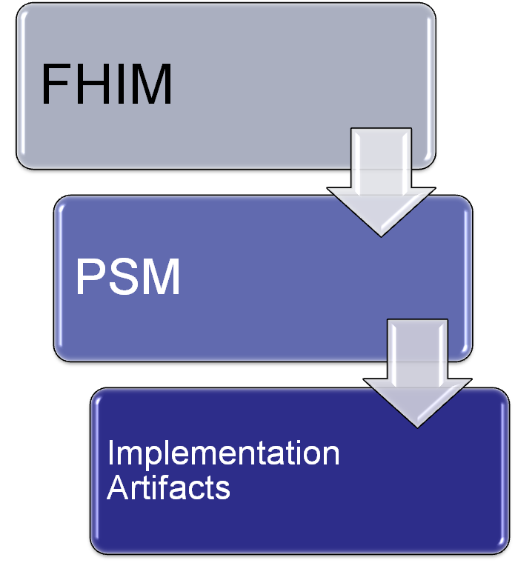
FHIM Conformance Considerations
CIM 1
CIM 2
CIM n
Conformance to a FHIM domain is validated by verifying conformance to a specific technology implementation (e.g. XSD, XSD + Schematron, programming API)

Slide 20













S&I Framework
Standards Development
Pilot Demonstration Projects
Use Case Development
and Functional Requirements
Harmonization of
Core Concepts (NIEM framework)
Implementation Specifications
Reference Implementation
Certification
and Testing
Scenario
Planning
NIEM IEPD Lifecycle
Create a NIEM Health standards harmonization process and governance framework
Establish roadmap for existing NHIN standards, MU harmonization, and non-MU health information exchange specifications
Establishes a repeatable, iterative process for developing widely reusable, computable implementation specifications
Establishing the tooling and repositories needed
Establishing the practices and guidelines for modeling
Enables semantic traceability so that useable code can be traced back to original requirements and definitions
Promotes transparency and collaboration from broad range of health stakeholders
18

Slide 21
Mapping of IM Project Models and Tools to S&I Framework
IM Project Models and Tools
Information and Terminology Modeling
Implementation Modeling
Implementation Modeling
Standards Development
Pilot Demonstration Projects
Use Case Development
and Functional Requirements
Harmonization of
Core Concepts (NIEM framework)
Implementation Specifications
Reference Implementation
Certification
and Testing
Scenario
Planning
NIEM IEPD Lifecycle
19

Slide 22
How the Models/Tools of the IM Project Support the S&I Framework
Direct engagement of the Federal partner community
Support for Federal partner priorities such as VLER and MU
Direct support of Federal partner use cases
Adoptable by all organizations - models and tools are freely available
Traceability to the use cases and functional requirements supported
Provides semantic and syntactic modeling constructs to support the definition of information
Harmonizes standards across the Federal partners and standards organizations

Slide 23
How the Models/Tools of the IM Project Support the S&I Framework
Able to integrate with and support the NIEM process
Supports the 3 OMG/MDA model abstractions - CIM, PIM, PSM
  FHIM content derived from CIMs
  FHIM model is a PIM
  PSM produced by MDHT
MDHT tools can produce multiple technology bindings (PSMs) for the same set of logical specifications
MDHT tools can generate certification/testing artifacts

Slide 24
IM Project Summary
The IM Project:
Produces freely available, harmonized information and terminology models
That are integrated with open source model-driven health tools
That can support multiple implementation platforms (PSMs), including NIEM
And that can support the goals and requirements of the S&I Framework

